Slide 1
Infection Control
Update
April 2025
Patti Mancos
Infection Control Officer
Methodist Hospitals

Slide 2
Alerts & Advisories

Slide 3
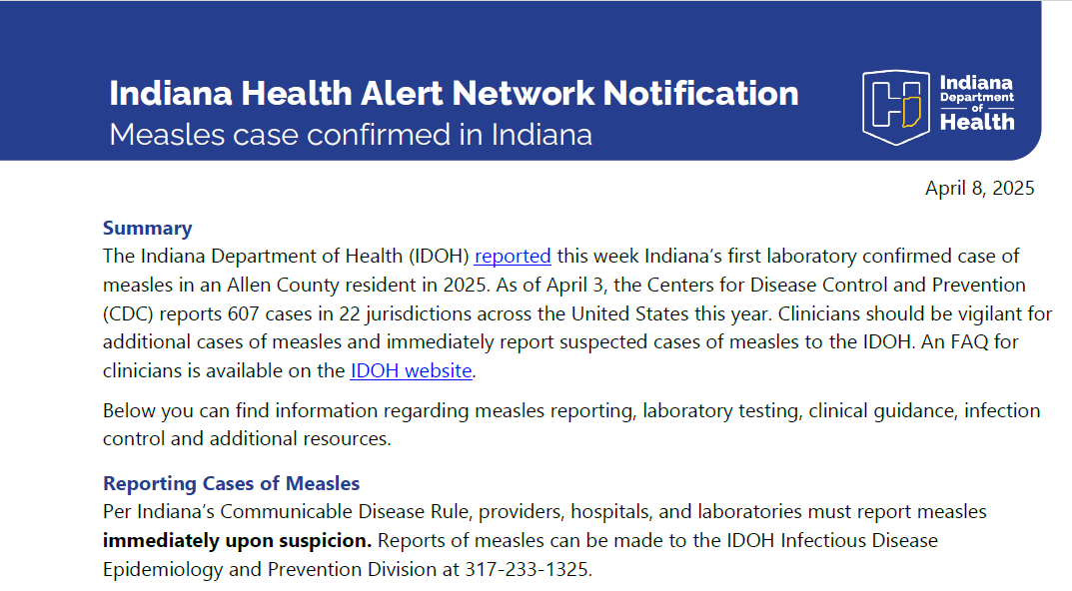

Slide 4
Measles Developments
5 additional recent cases in Indiana since the alert
  Related to the child in Allen County
  3 unvaccinated children, 2 adults with unknown vaccination status
712 confirmed cases in US in 2025 as of April 11
  Most related to Texas outbreak
  Cases in 25 jurisdictions: Alaska, Arkansas, California, Colorado, Florida, Georgia, Hawaii, Indiana, Kansas, Kentucky, Maryland, Michigan, Minnesota, New Jersey, New Mexico, New York City, New York State, Ohio, Oklahoma, Pennsylvania, Rhode Island, Tennessee, Texas, Vermont, and Washington.
Measles cases are increasing worldwide

Slide 5
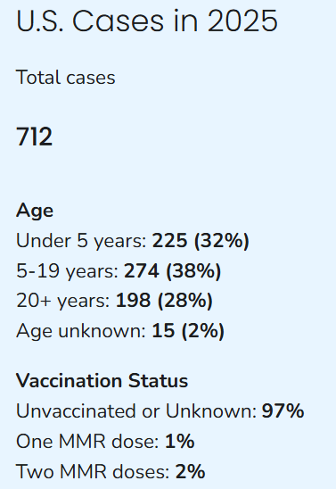
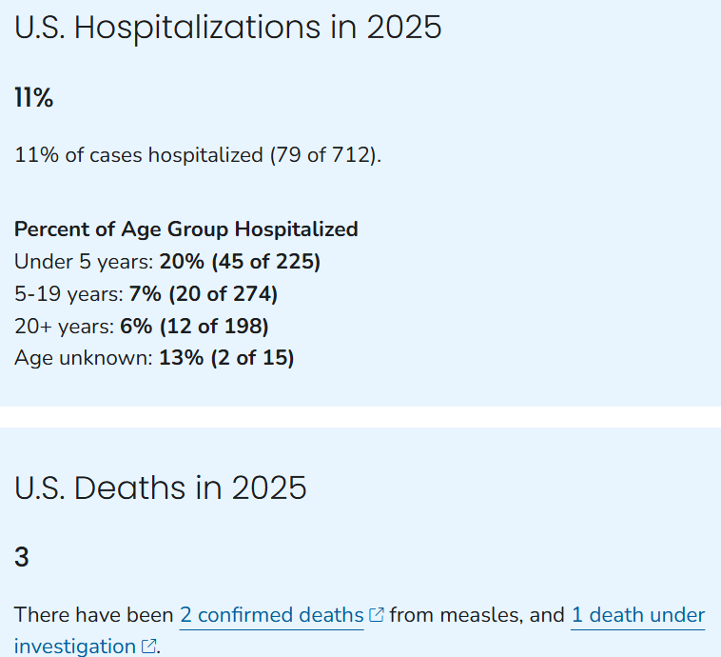

Slide 6
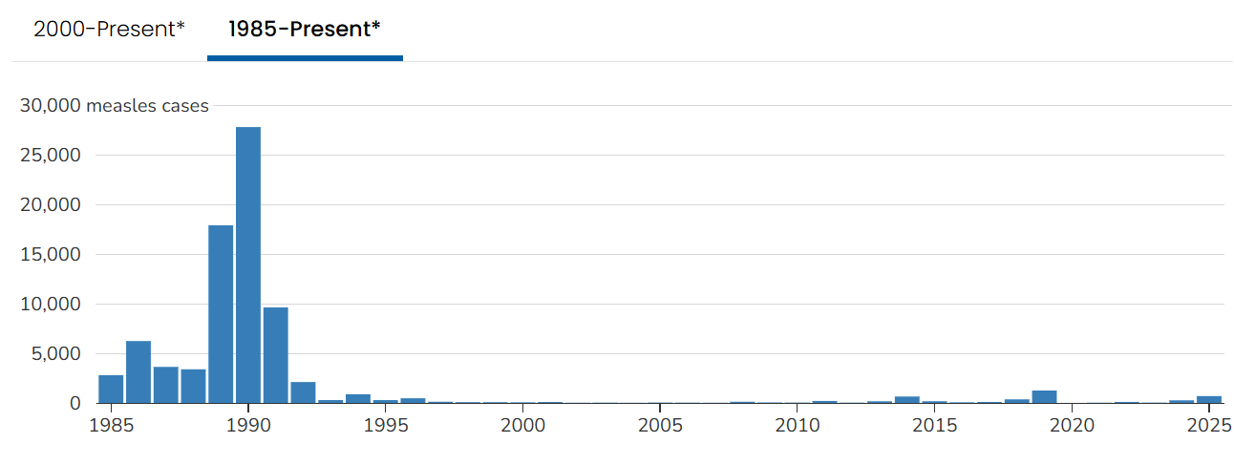

Slide 7
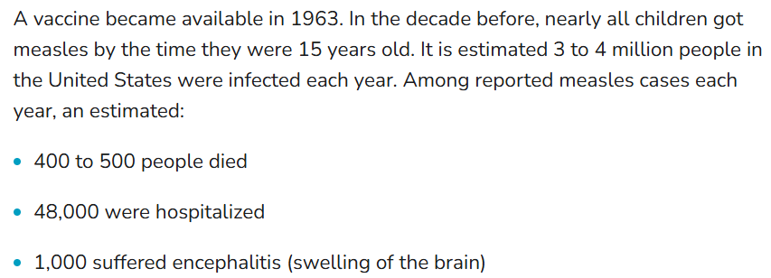
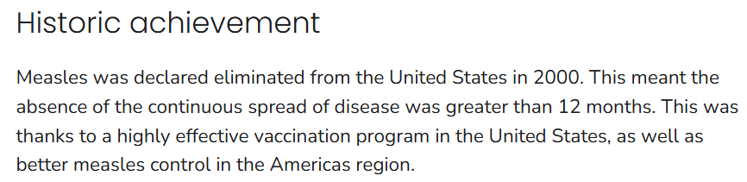

Slide 8
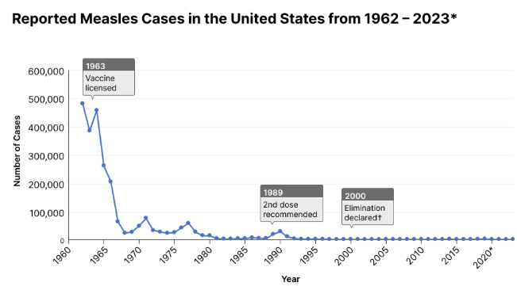

Slide 9
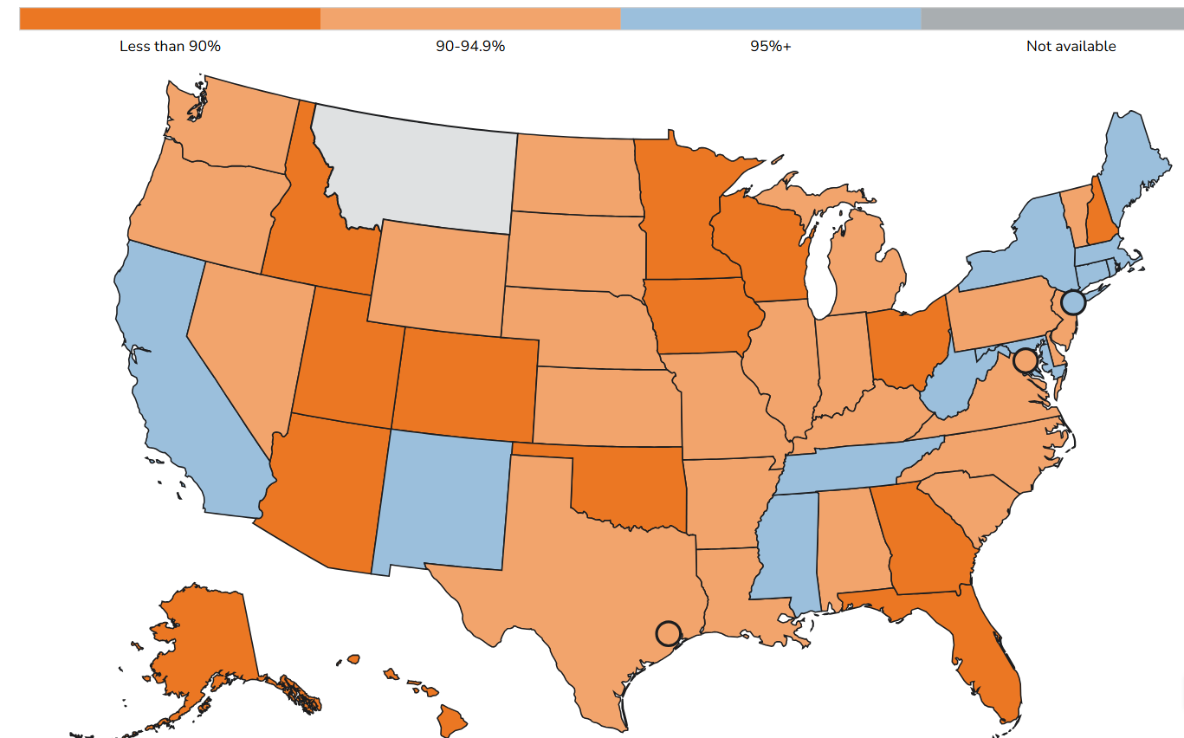
Percent Vaccinated
MMR vaccine coverage for kindergarteners
2023-2024

Slide 10
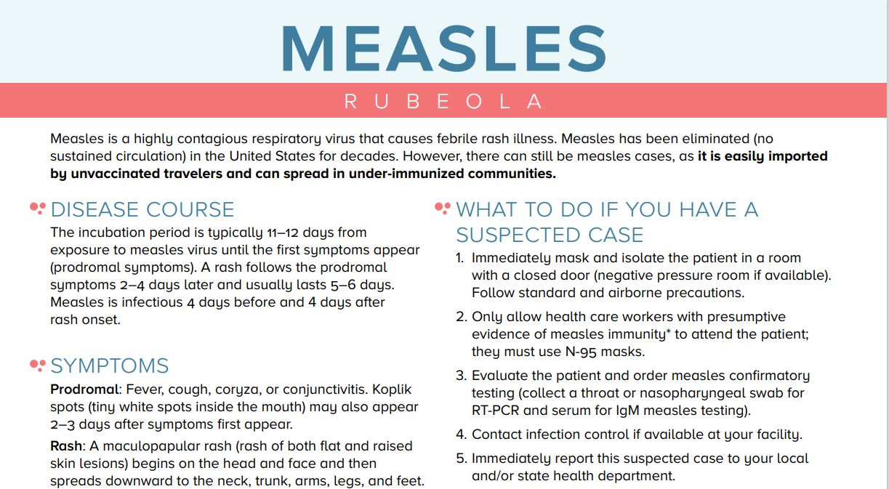

Slide 11
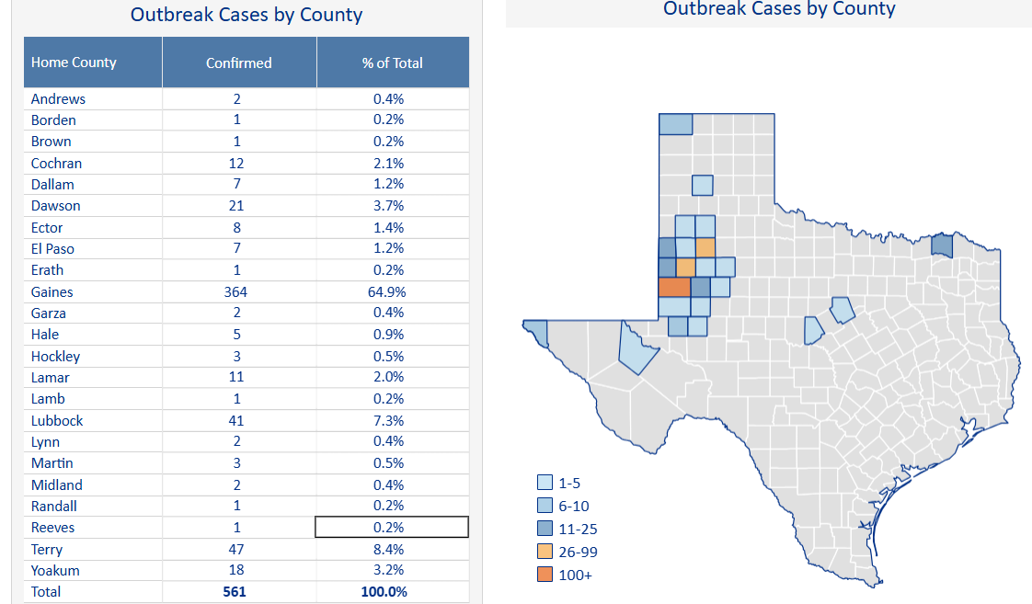
Texas Outbreak

Slide 12
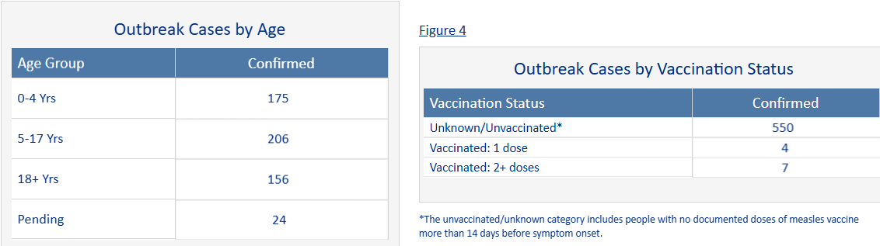
Texas Outbreak

Slide 13
Texas Outbreak
Multiple related cases in neighboring states
Deaths
2 deaths of unvaccinated school aged children reported in Texas
1 death of unvaccinated adult person in New Mexico (suspected)
Last fatality in a US child occurred in 2003
Last fatality in a US adult occurred in 2015

Slide 14
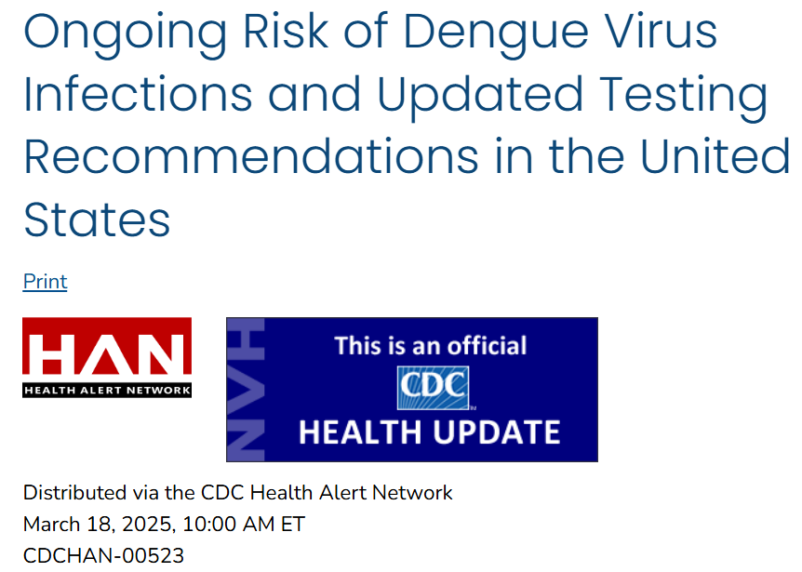
https://www.cdc.gov/han/2025/han00523.html?ACSTrackingID=USCDC_486-DM145733&ACSTrackingLabel=HAN%20523%20-%20Health%20Advisory%20(General%20Public)&deliveryName=USCDC_486-DM145733

Slide 15
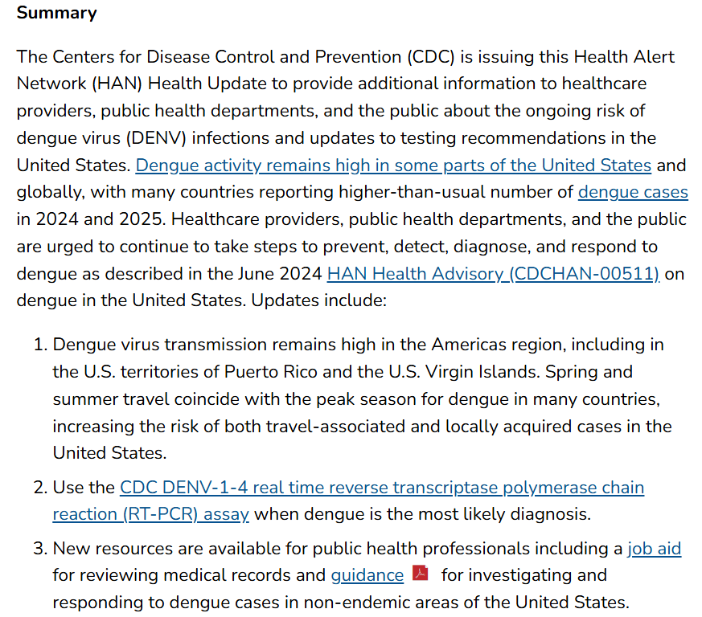

Slide 16
CDC’s Respiratory Virus
Surveillance Website
www.cdc.gov/respiratory-viruses/data/activity-levels.html
COVID-19
RSV
Influenza (seasonal)

Slide 17
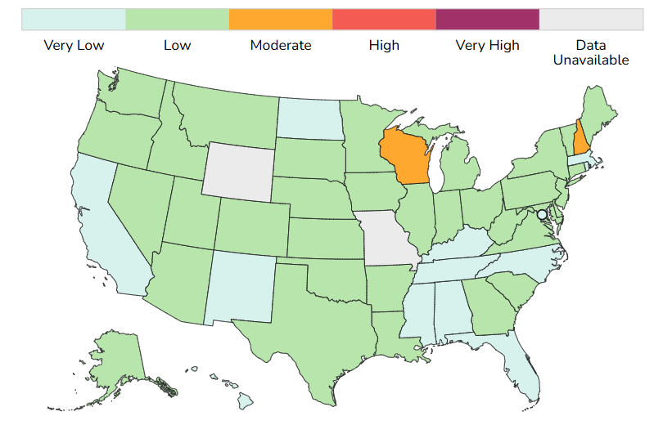
Acute Respiratory Illness

Slide 18
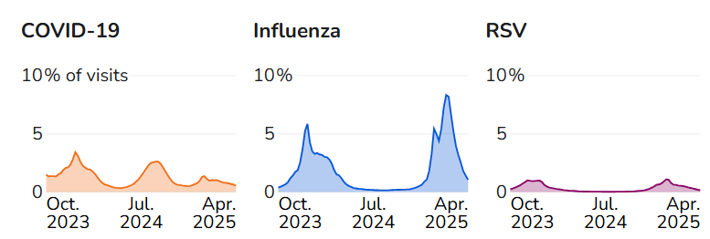
ER Visits- US

Slide 19
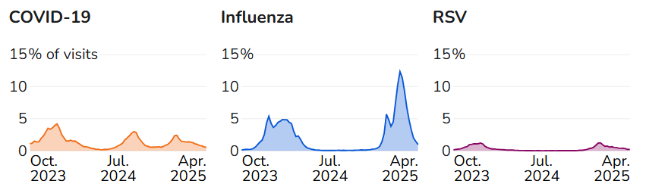
ER Visits- Indiana

Slide 20
Seasonal Influenza

Slide 21
2024-2025 Influenza Season
This season is classified as a high severity season overall and for all age groups (children, adults, older adults) and is the first high severity season since 2017-2018.
  188 pediatric deaths so far
Seasonal influenza (flu) activity continues to decline; however, CDC expects several more weeks of flu activity.

Slide 22
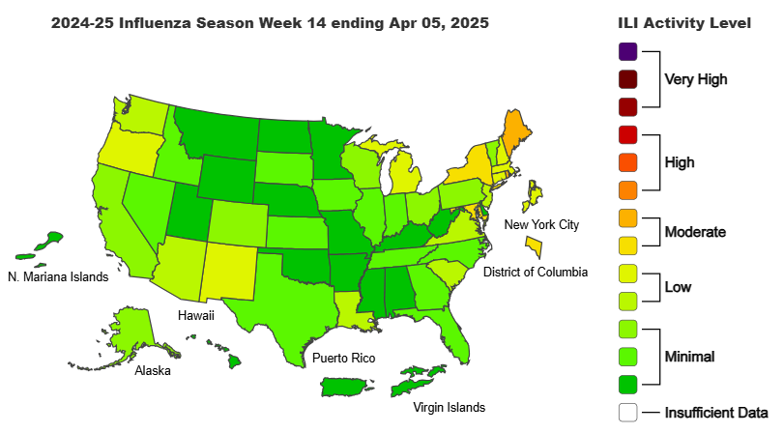
Influenza US Activity

Slide 23
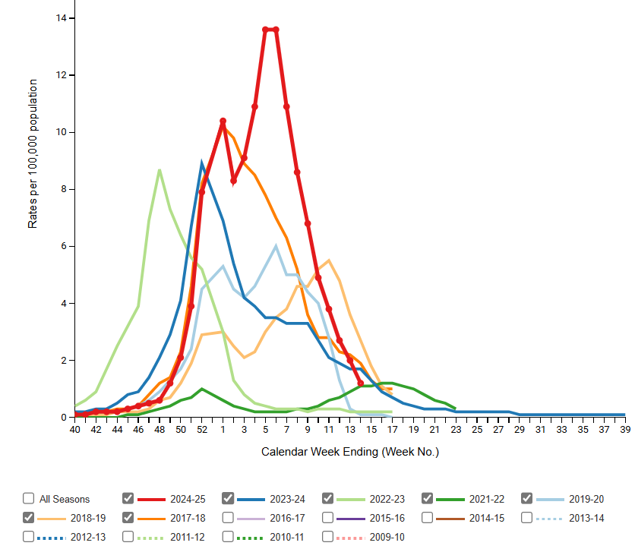
Influenza Hospitalizations

Slide 24
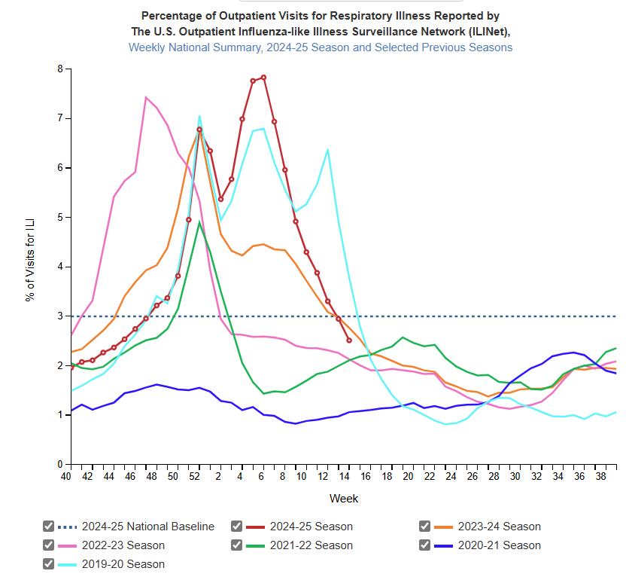
Outpatients with ILI- US

Slide 25
Seasonal Influenza Resources
Surveillance
www.cdc.gov/fluview/?CDC_AAref_Val=https://www.cdc.gov/flu/weekly/index.htm
Infection Control Guideline
www.cdc.gov/flu/hcp/infection-control/index.html

Slide 26
COVID-19 Disease
Caused by SARS-CoV-2 Virus

Slide 27
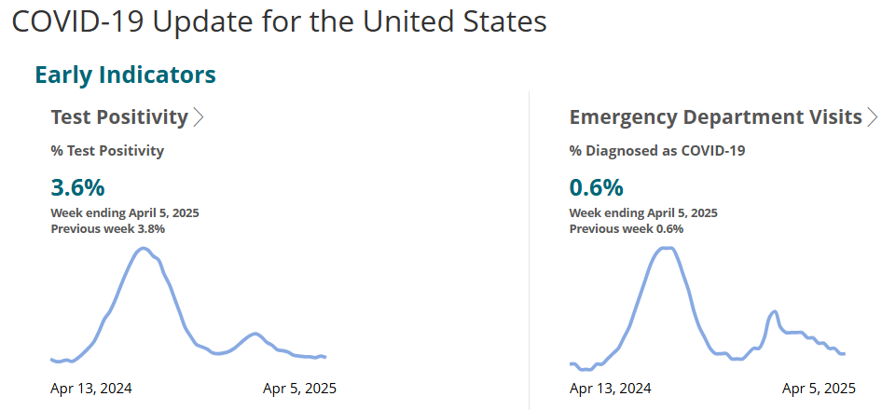
Early Indicators- COVID

Slide 28
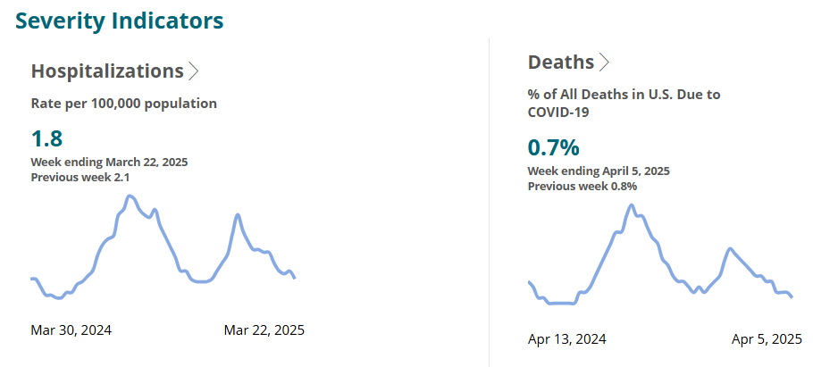
Severity Indicators- COVID

Slide 29
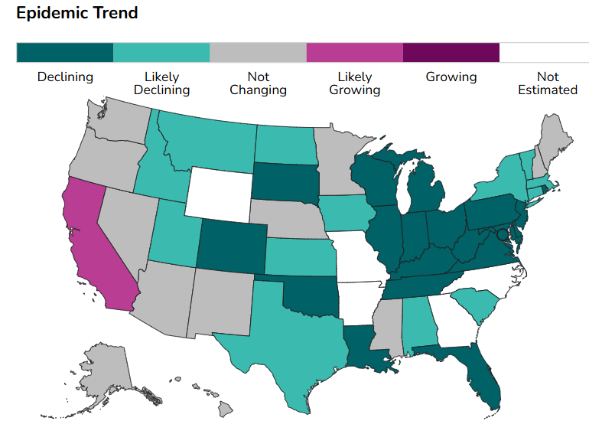
Epidemic Trend- COVID

Slide 30
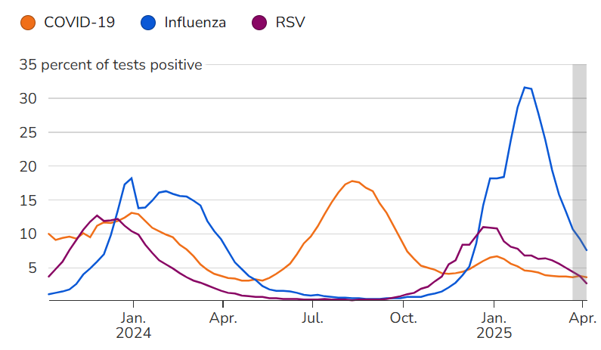
COVID not showing a Seasonal Pattern
Note:
2023-2024 we saw a winter surge of cases
2024 we saw a bigger surge in mid summer to early fall
2024-2025 relatively small increase in cases seen in winter months
What will 2025 summer, fall, and winter bring???

Slide 31
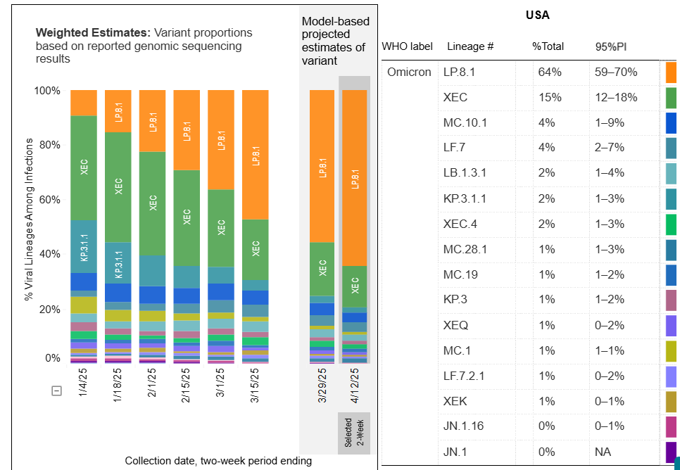
COVID Variants- US
LP.8.1 Omicron subvariant replacing XEC variant both are descendants of KP.1.1.3, which is part of the JN.1 lineage

Slide 32
COVID Resources
General Information
www.cdc.gov/covid/index.html
Surveillance
covid.cdc.gov/covid-data-tracker/#datatracker-home
Infection Control Guideline
www.cdc.gov/covid/hcp/infection-control/index.html
CIDRAP
www.cidrap.umn.edu

Slide 33
Highly Pathogenic Avian Influenza A H5

Slide 34
Current Situation H5N1
March marks 1 year since highly pathogenic avian influenza (HPAI) was first detected in dairy cattle in Texas, marking a significant shift in its spread to mammals.
Widespread infections continue in dairy cows, poultry, and wild birds in the US with sporadic human cases and other mammals
Clade 2.3.4.4b
  D1.1 genotype
    Currently spreading in wild birds and poultry
    Recently also being detected in dairy cattle
  B3.13 genotype
    Currently spreading in dairy cattle
Global data shows clade 2.3.4.4b can cause severe disease and death in humans

Slide 35
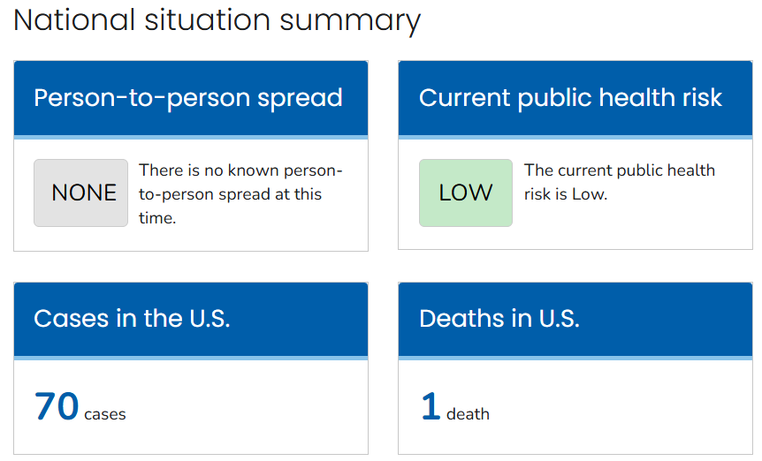
H5N1 Avian Influenza in the US
70 confirmed human cases + 7 probable cases

Slide 36
Current Situation
Detections in Animals
12,706 wild birds detected as of 4/8/2025
  51 jurisdictions with bird flu in wild birds
167,070,827 poultry affected as of 4/14/2025
  51 jurisdictions with outbreaks in poultry
1,009 dairy herds affected as of 4/14/2025
  17 states with outbreaks in dairy cows

Slide 37
New Developments
Mexico reported the country’s first confirmed human H5N1 case
  3 year old girl hospitalized in serious condition
  Northwest Mexico/ reported April 4, 2025
  No known exposure
UK – first detection in sheep
India & Cambodia- 2 fatal human cases of H5N1
  Children ages 2 & 3 years old
More recent detections in live poultry markets in New York

Slide 38
New Developments- Preparedness
United States
  The USDA’s APHIS last week announced $15.3 million in funding for research projects to enhance preparedness, early detection, and rapid response to the diseases that threaten US livestock.
  The funding will support 68 projects led by 24 state agriculture departments, five tribal entities, 35 universities, three livestock groups, and one federal partner. One third of the funding is geared toward enhanced biosecurity.
WHO- World Health Organization
  The World Health Organization (WHO) on April 11 released new guidance on surveillance for human infections with H5 avian influenza viruses.
  The goal is to rapidly detect and characterize any human H5 infections to allow prompt response actions, assess trends and health risks, and guide global flu pandemic preparedness.

Slide 39
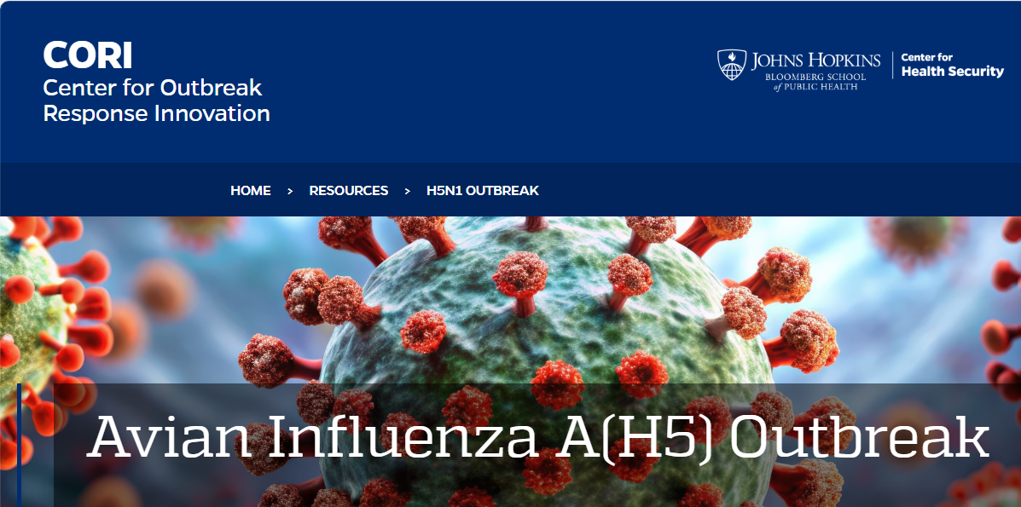
Updated April 8, 2025

Slide 40
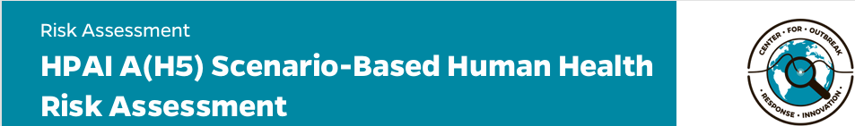
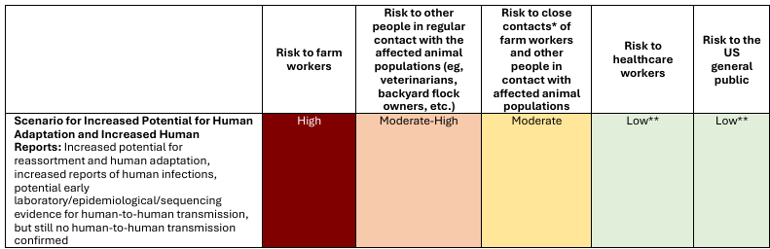

Slide 41
Influenza A H5 Resources
Johns Hopkins CORI
cori.centerforhealthsecurity.org/resources/avian-influenza-ah5-outbreak
CDC
www.cdc.gov/bird-flu/index.html
www.cdc.gov/bird-flu/hcp/novel-flu-infection-control/index.html
USDA
www.aphis.usda.gov/livestock-poultry-disease/avian/avian-influenza/hpai-livestock
CIDRAP
www.cidrap.umn.edu

Slide 42
Thank you!

